Slide 1
A Data Analysis project on Gender-Neutral Baby Names in the United States From 1880-2020
Shawn Behrend
Colorado State University Global
MIS581: Capstone: Business Intelligence and Data Analytics
Dr. Orenthio Goodwin
15 May 2022
Notes:
Hello – My name is Shawn Behrend and I'm going to be briefing my Data Analysis project with topic of Gender-Neutral Baby Names in the United States From 1880-2020.

Slide 2

Purpose
Discussion of this data analysis project
Objectives
Explanation of dataset
Tools for the analysis
Research questions
Findings
Figure 1. From “Matrix movie still”, by M. Spiske, 2018,
Unsplash. (https://unsplash.com/photos/iar-afB0QQw).
Notes:
The purpose of this briefing is to discuss the objectives for the project, the dataset itself, the tools used, the research questions and hypotheses, and the findings for the project.

Slide 3

Objectives of Data Analysis Project
Gender-specific vs gender-neutral
Explore, analyze and gain understanding of usage of gender-neutral baby names in the United States through analysis of trends by decade
Subject of interest for author
Few advantages - many disadvantages
Learn about popularity increase/decrease
Figure 2. From “Baby in white shirt and black pants laying on brown carpet”, by Lingchor, 2021.Unsplash. (https://unsplash.com/photos/cEbjAORB_I4).
Notes:
The majority of chosen baby names in the United States are gender-specific, meaning they are used for a particular gender, either male or female. A small minority of chosen baby names are considered gender-neutral, androgynous or unisex, meaning they can be used for either a male or a female (Seguin et al., 2021).
This project involves an analysis of trends by decade for gender-neutral names in the United States. The objective is to explore, analyze and gain insights about gender-neutral baby names based on the previously mentioned "Baby Names from Social Security Card Applications - National Data" dataset for years 1880-2020, published by the Social Security Administration (Nuessel, 2017; SSA, 2021).
This subject is of personal interest to me, as growing up with the gender-neutral name Shawn has had few advantages and many disadvantages. Learning about use of gender-neutral names over many decades, and how their popularity has increased or decreased was the inspiration for this study.

Slide 4
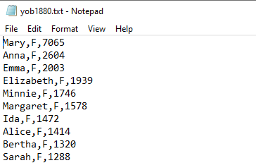
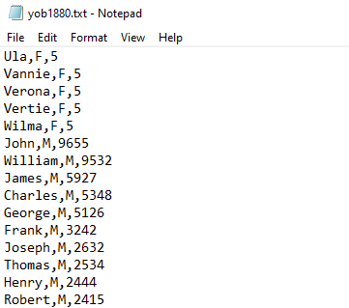
The dataset
"Baby Names from Social Security Card Applications - National Data“ published by the Social Security Administration (SSA, 2021)
One file per year of birth, ex. yob1880.txt
Contains Top 1000 names each for males and females
Top of datafile: Female names
Middle of datafile:
Male names
Notes:
The Social Security baby names dataset consists of one data file per Year-of-Birth for the years 1880-2020. As each year passes, the baby names for that year are published and added to the dataset. Each Year-of-Birth data file contains three columns in a Comma Separated Value (CSV) format, where female names are at the top, followed by male names. The Top 1000 most popular names for females and males are included in each file. Two excerpts from the 1880 Year-of-Birth file are shown.
As is seen in the upper portion, the name Mary had the highest number of Social Security applications for females with 7065 occurrences. This means Mary was the #1 ranked name for females. The example Year-of-Birth file also shows the center of the yob1880.txt file, where the male names follow the female names. For the male names, John had the highest number of Social Security applications for males with 9655 occurrences, meaning John was the #1 ranked name for males.

Slide 5
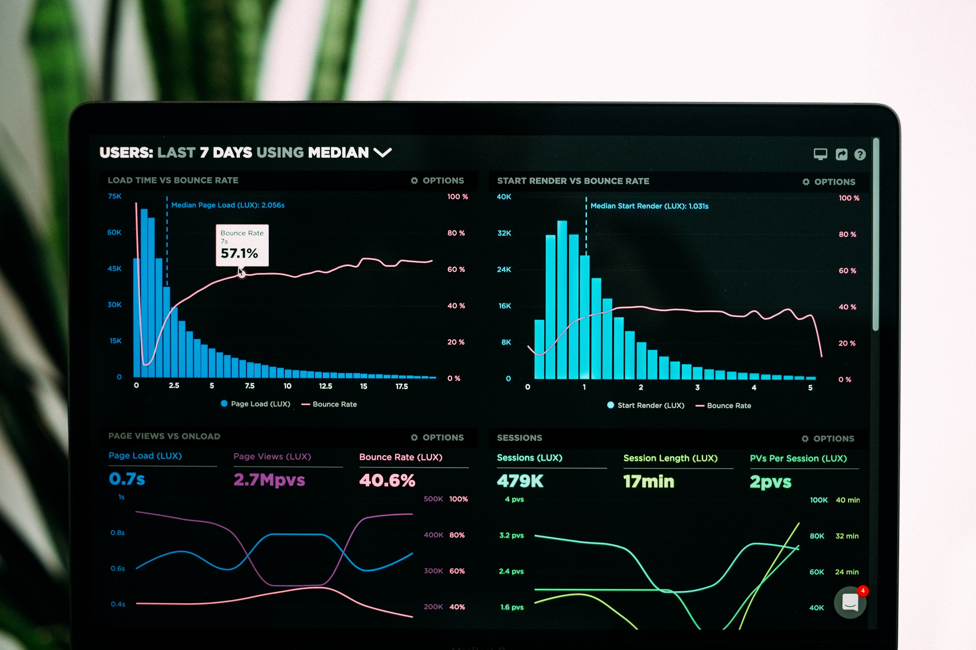
TOOLS used for analysis
Data analysis tool
Data preparation/ingestion
Statistical calculations
Visualizations
Spreadsheet
visual inspection of data
alphabetizing/ordering
Figure 3. From “Graphs of performance analytics on a laptop screen”, by L. Chesser, 2019, Unsplash. (https://unsplash.com/photos/JKUTrJ4vK00).
Rstudio and Microsoft Excel were used for analysis
Notes:
Two tools were necessary for the analysis for this project. The first was a data analysis tool which is used to ingest the data, perform statistical calculations, and plot visualizations of the data as directed by the coded tasks. The second tool is a spreadsheet to ingest the resultant data from the data analysis tool for visual inspection, as well as to perform basic tasks such as alphabetizing and numerical ordering
Some commonly used data analysis tools are R Studio, Python/Jupyter Notebook, and SAS. All have similar analytical capabilities for statistical data analysis as well as plotting capability for relevant charts and graphs. For this project, R Studio was used as R is the coding language I am most familiar with. Additionally there are vast amounts of online help for any and all questions on coding using the R language. The spreadsheet tool used was Microsoft Excel.

Slide 6
Research question 1 and Hypotheses
Research Question 1 and Hypotheses
Research Question 1 | Is there a trend in quantity of unique gender-neutral baby names (same name and spelling used for both males and females) being used versus the overall name set by decade from 1880-2020?
Hypotheses | H₀: The ratio of quantities of unique gender-neutral names versus the complete set of names used in each decade per gender has stayed the same in the decades from 1880-2020
 | H_{A}: The ratio of quantities of unique gender-neutral names versus the complete set of names used in each decade per gender has changed in the decades from 1880-2020
Notes:
The research questions and hypotheses for this project are shown on this slide and the next.
Research question 1 asks if there is a trend in quantity of unique gender-neutral baby names (same name and spelling used for both males and females) being used versus the overall name set by decade from 1880-2020. The null hypotheses states that the ratio of quantities of unique gender-neutral names versus the complete set of names used in each decade per gender has stayed the same in the decades from 1880-2020. The alternative hypothesis states that the ratio has changed in those same decades.

Slide 7
Research question 2 and Hypotheses
Research Question 2 and Hypotheses
Research Question 2 | Is there a trend in usage of unique gender-neutral baby names (number of occurrences by both males and females) versus the overall occurrence of name usage by decade from 1880-2020?
Hypotheses | H₀: The ratio of total occurrences of gender-neutral names versus the total occurrences of all names used in each decade per gender has stayed the same in the decades from 1880-2020
 | H_{A}: The ratio of total occurrences of gender-neutral names versus the total occurrences of all names used in each decade per gender has changed in the decades from 1880-2020
Notes:
Research question 2 asks if there is a trend in usage of unique gender-neutral baby names (meaning the number of occurrences by both males and females) versus the overall occurrences of name usage by decade from 1880-2020. The null hypotheses states that the ratio of total occurrences of gender-neutral names versus the total occurrences of all names used in each decade per gender has stayed the same in the decades from 1880-2020. The alternative hypothesis states that the ratio has changed in those same decades.

Slide 8
Research design – Methodology & Methods
Quantitative research, descriptive analysis
Name, gender, occurrences
Names in both female and male Top 1000 with same spelling
Analysis of trends over 14 decades
Quantity of gender neutral names
Occurrences of gender neutral names
For hypotheses determination
Visualizations (Scatter plots, Line plots for trends)
Statistical Pearson correlation test
Notes:
As mentioned in Research Question 1 and Research Question 2, the data that was collected and analyzed consists of names for which Social Security applications were submitted, which are the same for both males and females within the fourteen decades shown here: 1880-1889, 1890-1899, 1900-1909, and so on up to 2010-2020. Names are considered to be gender-neutral if they appear in both the male and female list and have identical spelling (SSA, 2021). A complete year of birth data file was used, so the data searched included the top 1000 names for males, and the top 1000 names for females for that year. In order to do this analysis per decade, the last year of the decade was used as the search set for the names that were used for both genders.
The research method for this project was to analyze the name dataset per year to search for trends of gender-neutral name usage, as well as to visually show the trends in tables and plots. To prove or disprove the hypotheses for Research Questions 1 and 2, scatter plots were created to look for trends in the time-based data. Using R, the Pearson Correlation test was also done per gender for all years in the dataset to evaluate association between the occurrences of gender-neutral names versus occurrences of all names, per gender (Davies, 2016)
The table on the right shows ten names used by both females and males in 2020. As is seen for these names in particular, the upper five are used much more often for males than females, while the lower five are used more often for females than males.

Slide 9
Research design – Limitations & ethical considerations
Limitations
Social Security program began in 1935; Less names in dataset between 1889 and 1986 due to Tax Reform Act of 1986
Gender and name spelling errors on applications were not corrected
Names can be used for both genders but could have different popularity/rank
Ethical Considerations
U.S. Department of Labor defines Personally Identifiable Information (PII)
Full name, address, Social Security Number, telephone number, email address
No ethical concerns as SSA data set includes only first name and year of birth for names that have 5 or more applications
Notes:
Prior to the Tax Reform Act of 1986 (99th Congress, 1986), U.S citizens were required to apply to join the Social Security program. Nuessel (2017) notes that the names included in the Social Security dataset were gathered from Social Security card applications for those born after 1879. After the Tax Reform Act of 1986 was passed, all U.S.-born children's names from 1987 and beyond appeared in the data file for their year of birth. Therefore, there are many more data points after 1986 than there were previously.
Nuessel (2017) provides two additional limitations about the Social Security names dataset that apply directly to this project:
The dataset includes gender and spelling as was recorded on the Social Security application. No edits were done if incorrect.
Names can be used for both genders, but will have differing ranks in popularity per gender.
The United Stated Department of Labor (US DoL) defines Personally Identifiable Information (PII) as information that allows the identity of an individual to be inferred. Examples of PII that identify individuals directly are full name (first, middle and last), address, social security number, telephone number, and email address (US DoL, n.d.).
For this project, there are no ethical concerns that need to be taken into account. The data fields in the SSA name dataset include only the individual's first name, their gender and their birth year. The dataset includes U.S. born applicants for the U.S. Social Security program, but no other geographic information is included. Additionally, care was taken by the SSA to include only names that appear five times or more, such that no individual could be directly identified and privacy is preserved (Nuessel, 2017; SSA, 2021).

Slide 10
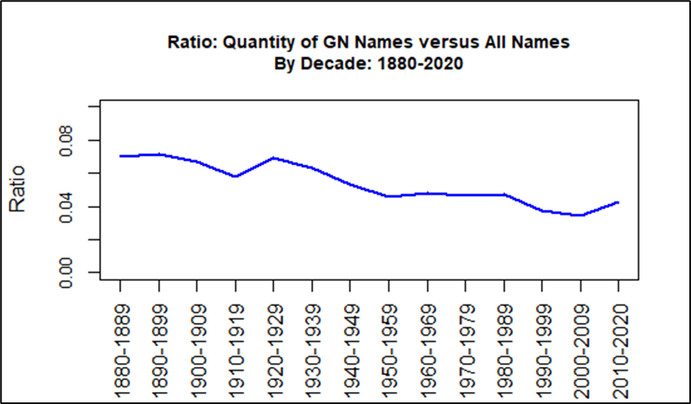
Findings – Research Question 1
Quantity of unique gender-neutral names used per decade
Ratio of gender neutral names versus total number of names is plotted
Total names is 1000 each for males and females = 2000
Ratio = 0.07 to 0.043 over timespan
Null hypothesis rejected
Fewer unique gender neutral names were used over 140 years
Notes:
Research Question 1 asks about the quantity of unique gender-neutral names, with same spelling, used for both males and females. For ease of visualization of this data, the ratio of the quantity of gender-neutral names versus the total number of names per decade is shown. As is seen in the figure, the quantity of gender-neutral names used decreases from a ratio of 0.07, or 7%, in 1880 down to 0.043 or 4.3% in 2020, indicating that use of gender-neutral names has decreased over 140 years. Based on this visualization it is clear that the null hypothesis for Research Question 1 can be rejected as there is a downward trend of gender-neutral names being used through the 140-year time period.

Slide 11
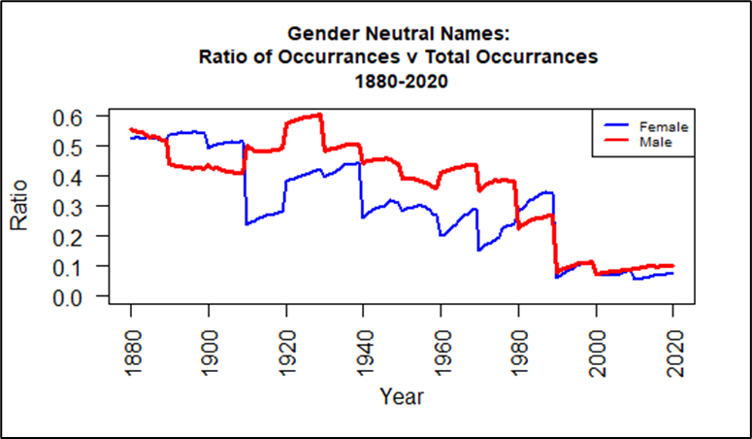
Findings – Research Question 2
Occurrences of unique gender-neutral names used per decade per gender
Ratio of occurrences of gender neutral names versus total occurrences of all names per gender is plotted
Ratio was even at first, higher for males, then even again at end of timespan
Null hypothesis rejected
Usage of gender neutral names decreased over 140 years
Notes:
Research Question 2 asks about the number of occurrences of unique gender-neutral names, with same spelling, used for both males and females. Preparation of the data included compilation of the sum of the number of occurrences of gender-neutral names per gender, versus the total occurrences of all names for that gender. Data for every year in the 140-year time period was compiled and plotted to develop a comprehensive picture of the trend.
As is seen in the figure, the ratio of occurrences varies per gender, with the female occurrences shown in blue and male occurrences shown in red. While the use of gender-neutral names was fairly even for both females and males in 1880, it is seen that the usage of gender-neutral names, which are usually considered to be more masculine, was more popular for males in the years and decades that follow than for females. It is also seen that there is a downward trend in use of gender-neutral names for either gender over the 140-year time period. This downward trend is a clear indicator that the null hypothesis for Research Question 2 can be rejected.

Slide 12
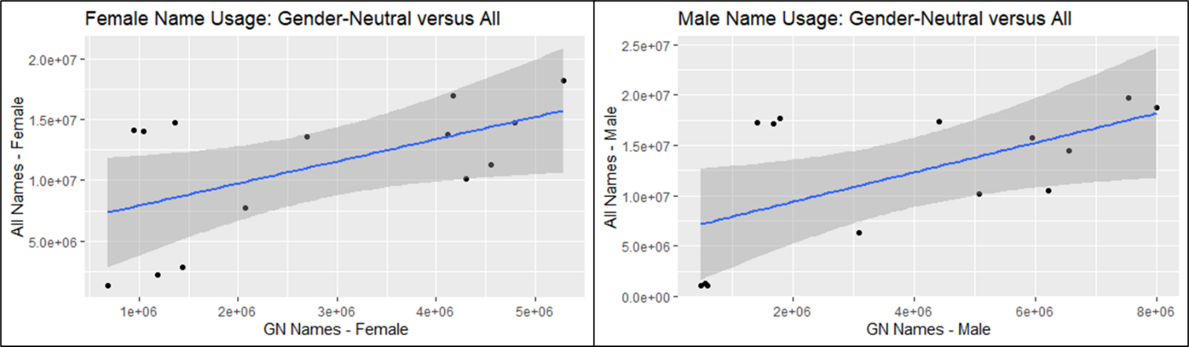
Findings – Research Question 2
Pearson’s correlation evaluated association between occurrences of gender neutral names versus all names, per gender
Not statistically significant
0.038 (F) and 0.03 (M) vs 0.05 significance level
Notes:
As an additional method of analysis for Research Question 2, scatter plots were made and the Pearson correlation test was used to evaluate the association between occurrences of gender-neutral names and occurrences of all names, per gender. The upper figure shows the scatter plots where the female occurrences are on the left portion and the male occurrences are on the right portion. The lower part of the figure shows the Pearson's correlation test results with female names in the left portion and male names in the right portion. As can be seen, the p-values are similar with females at 0.038 and males at 0.03. These p-values are very close to the significance level of 0.05. Therefore, the correlation of the occurrences of gender-neutral names versus all names is not statistically significant for either gender.

Slide 13
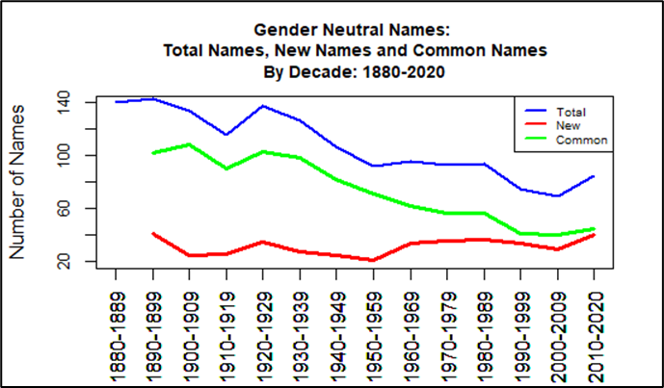
Findings – New/common names
Hahn & Bentley (2003) theory: New names are invented and others fall into dis-use with every decade
While gender-neutral names decrease in use overall, there is an increase in new gender-neutral names being introduced
Notes:
Hahn & Bentley (2003) stated that new names are invented and others fall into dis-use with every decade. Analysis was done beginning with the 1880-1889 decade to determine whether gender-neutral names in following decades were either in common with the previous decade, or were new for that decade. In some cases, a gender-neutral name was included in a decade, but then skipped one or more decades before appearing in the list again. If this happened, that particular name was considered common in some decades and new in a decade further on. This occurred with the name Charlie, which was considered common since 1889. The name falls into disuse as a gender-neutral name in the years from 1950-1999, but then reappears in 2000-2009. A plot of the quantity of gender-neutral names and their status of New or Common is shown in the figure on the left along with the total number of gender-neutral names used for the 14-decade time period.
As shown in the figure on the left, the total number of gender-neutral names is plotted in blue. Gender-neutral names that were in common with the previous decade are shown in green. This line trends downward as the decades went on. Gender-neutral names that were new in each decade are shown in red. Interestingly, the number of new gender-neutral names increases from 1950 to 2020. The number of new gender-neutral names nearly reaches the level of the gender-neutral names that were in common with the previous decade. It can be speculated that parents desired gender-neutral names for children, but did not want to use the same names that previous generations had used. They instead introduced new gender-neutral names.
Because this study was of particular interest to the author, the plot on the right shows the occurrences of the name “Shawn” for both males and females from 1950 when it was introduced on both lists to 1979 when it was no longer in the name files for females. As is seen, the name “Shawn” with its spelling, was equally popular for males and females through 1956. After that, the name was still used for females, but was much more popular for males.

Slide 14
Conclusion & recommendations For Data Analysis Project
Null Hypotheses for Research Question 1 and 2 were both rejected
Significant decrease in both quantity and occurrences of gender-neutral names being used from 1880-2020, and correlation between usage of gender-neutral names versus all names was not statistically significant for either males or females
Usage of common gender-neutral names decreased overall while usage of new gender-neutral names increased over the last 50 years
Further analysis will require the addition of new year of birth files as more are published year by year and it is recommended that analysis should be done at the end of each decade to enable gathering of the most useful set of data
Notes:
In conclusion, this study analyzed trends and correlation in usage of gender-neutral children's names over 14 decades, from 1880-2020. Research Question 1 involved the quantity of gender-neutral names being used overall. For this question, the null hypothesis was rejected, meaning that there was a difference in quantity of gender-neutral names being used per decade. The analysis showed there was a significant decrease in quantity of gender-neutral names being used from 1880-2020.
Research Question 2 involved the number of occurrences of gender-neutral names being used per gender versus all names. For this question, the null hypothesis was rejected, meaning that there was a difference in number of occurrences of gender-neutral names per decade, per gender. The analysis showed there was a significant decrease in occurrences of gender-neutral names being used from 1880-2020 for both males and females. Additionally, the correlation between usage of gender-neutral names versus all names was not statistically significant for either males or females.
Lastly, analysis was done on gender-neutral names being commonly used as decades go on versus new gender-neutral names being introduced. This analysis showed that while usage of many common gender-neutral names decreased and names fell into dis-use, there was an increase in new gender-neutral names being added over the last 50 years.
Further analysis of trends in the use of gender-neutral names in the United States in the future will require addition of new YOB files as more are published when each year passes. It is recommended that future analysis be done at the end of each decade to enable gathering of the most useful set of data, which includes a full decade worth of name data.

Slide 15
References
Associated Press. (2018, March 21). Why gender-neutral baby names are on the rise. New York Post. https://nypost.com/2018/03/21/why-gender-neutral-baby-names-are-on-the-rise
Barry, III, H. & Harper, A. (1982). Evolution of Unisex Names. Names: A Journal of Onomastics, 30(1), 15–22. https://doi.org/10.1179/nam.1982.30.1.15
Chesser, L. (2019). Graphs of performance analytics on a laptop screen [Stock Image]. Unsplash. https://unsplash.com/photos/JKUTrJ4vK00
Cote, C. (2021). 5 principles of data ethics for business. Harvard Business School Online. https://online.hbs.edu/blog/post/data-ethics
Davies, T. (2016). The Book of R, A First Course in Programming and Statistics. San Francisco, CA: No Starch Press.

Slide 16
References
Hahn, M., & Bentley, R. (2003). Drift as a mechanism for cultural change: An example from baby names. Proceedings: Biological Sciences, 270, S120–S123. https://doi.org/10.1098/rsbl.2003.0045
Howe III, E., & Elenberg, F. (2020). Ethical Challenges Posed by Big Data. Innovations in Clinical Neuroscience, 17(10-12), 24–30
Lieberson, S., Dumais, S., & Baumann, S. (2000). The instability of androgynous names: The symbolic maintenance of gender boundaries. American Journal of Sociology, 105(5), 1249–1287.
Lingchor. (2021). Baby in white shirt and black pants laying on brown carpet [Stock Image]. Unsplash. https://unsplash.com/photos/cEbjAORB_I4
Nuessel, F. (2017). A note on popular baby names on the Social Security website: An important onomastic resource. Names: The Journal of the American Name Society, 65(1), 45–50. https://doi.org/10.1080/00277738.2016.1197651

Slide 17
References
O'Leary, Z. (2021). The essential guide to doing your research project. SAGE Publications Ltd.
Seguin, C., Julien, C., & Zhang, Y. (2021). The stability of androgynous names: Dynamics of gendered naming practices in the United States 1880–2016. Poetics, 85. https://doi.org/10.1016/j.poetic.2020.101501
Spiske, M. (2018). Matrix movie still [Stock Image]. Unsplash. https://unsplash.com/photos/iar-afB0QQw
Social Security Administration (SSA). (2021). Baby names from Social Security card applications - National data. Data.gov. https://catalog.data.gov/dataset/baby-names-from-social-security-card-applications-national-data
United States Department of Labor (US DoL). (n.d.) Guidance on the Protection of Personal Identifiable Information. Dol.gov. https://www.dol.gov/general/ppii

